Slide 1
Policy Gradient Methods
Hongning Wang
CS@UVA

Slide 2
Outline
Policy Gradient Theorem
REINFORCE: Monte Carlo Policy Gradient
Actor–Critic Methods

Slide 3
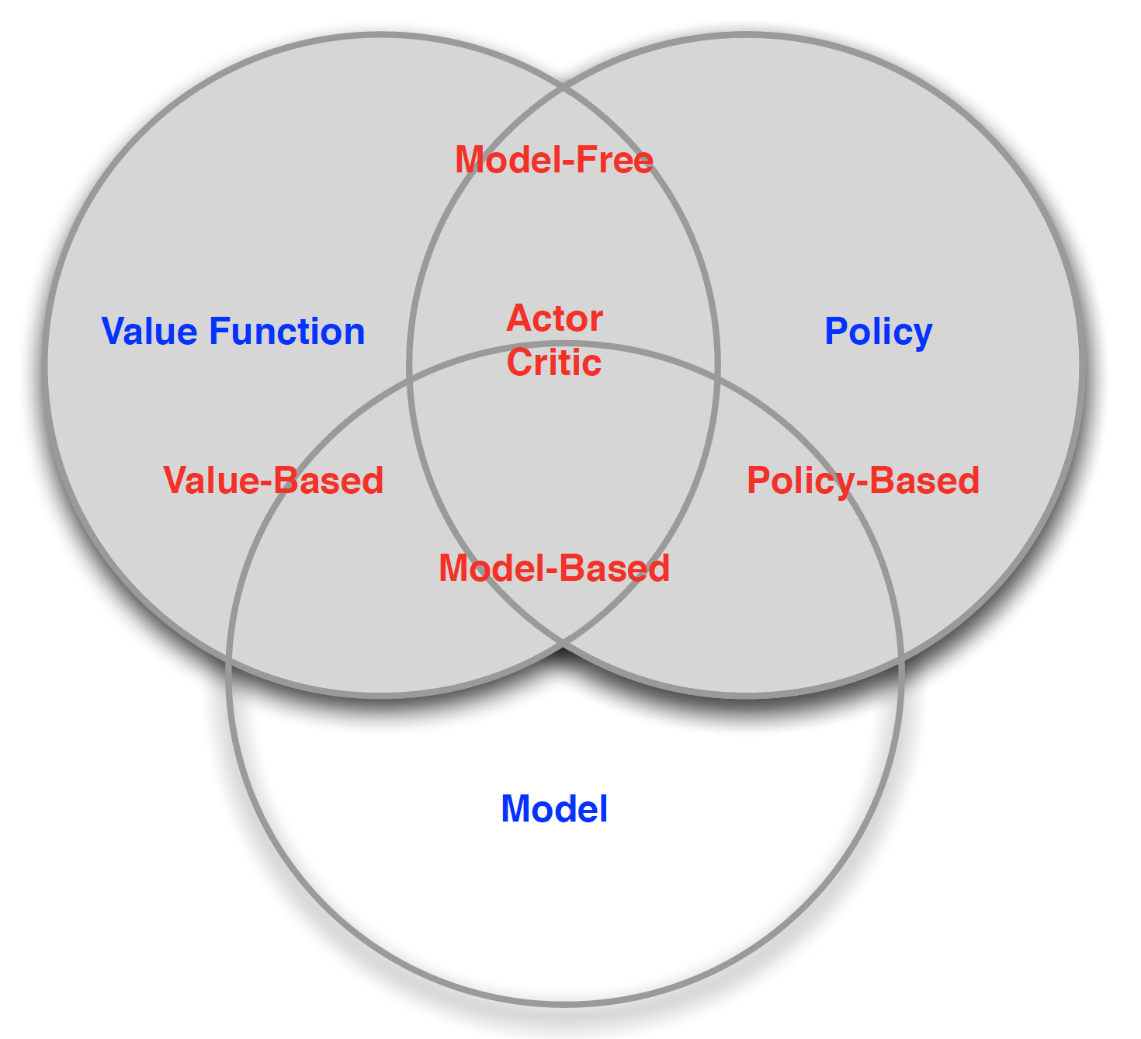
A taxonomy of RL solutions
Focus of today!
TD, MC
DP
Figure credit: David Silver, “Introduction to RL”

Slide 4
How to derive a policy
Value-based approaches
State value function + environment model
One-step look ahead in dynamic programming
Action value function
$ε$-greedy or any other of your favorite bandit algorithm!
Directly parameterize and learn the policy
$π\left(a | s\right)=f_{θ}\left(φ(s,a)\right)$
E.g., $π\left(a | s\right)∝\exp\left(θ^{⊤}φ(s,a)\right)$
Feature vector of state-action pair
Temperature of soft-max
No need to be related to the value function!
Why not directly define $π\left(a | s\right)∝exp⁡({λv\left(s,a\right)})$?

Slide 5
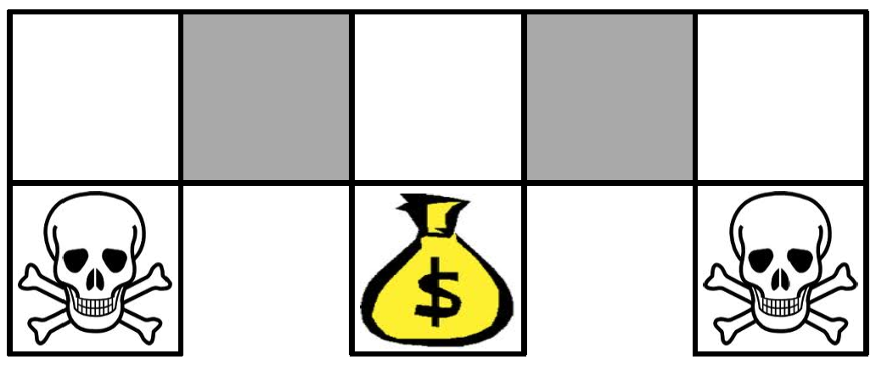
Advantage of direct policy learning in a toy example
Two identical states in terms of feature representation $φ\left(s,a\right)$; hence, they would have the same policy in value-based methods
$ε$-greedy as an example
An optimal stochastic policy should randomize the actions at these two states
$π\left(a | s\right)∝\exp\left(θ^{⊤}φ(s,a)\right)$ will work!

Slide 6
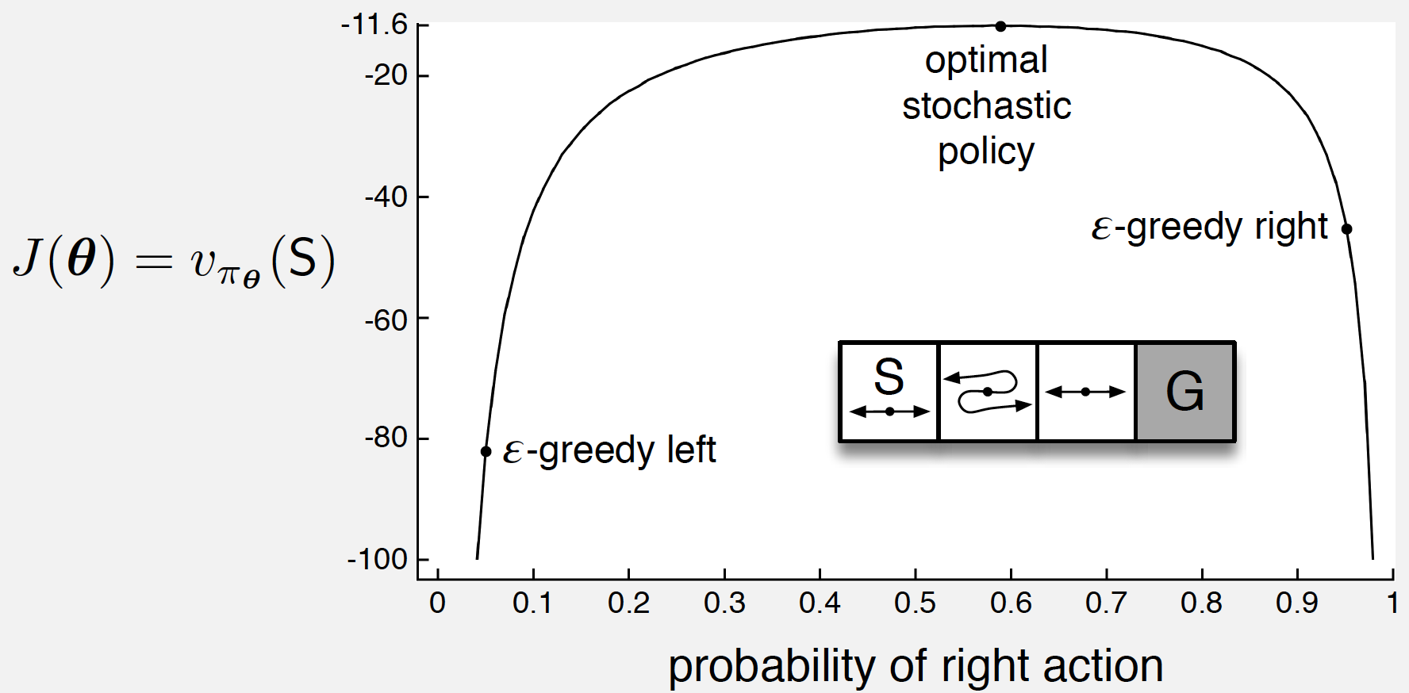
Advantage of direct policy learning in a toy example

Slide 7
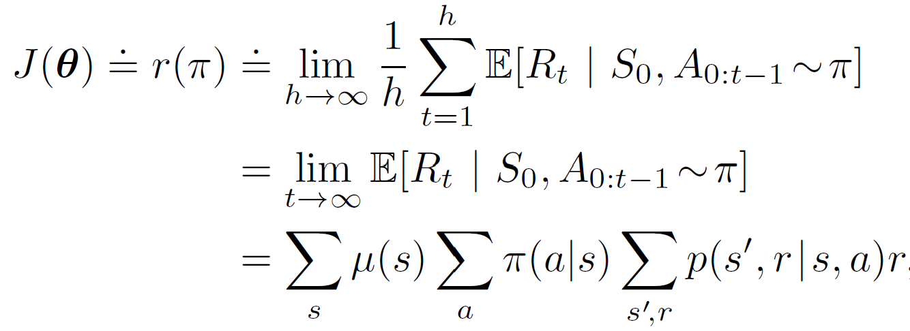
Policy learning as an optimization problem
Objective function $J(θ)$
In an episodic environment
Value of a particular initial state $J\left(θ\right)=v_{π_{θ}}\left(s_{0}\right)$
In a continuous environment
Average rate of reward per time step
Then how should we optimize it?
Gradient ascent!
Stationary state distribution under policy $π\left(a | s\right)$, needs an ergodic environment

Slide 8
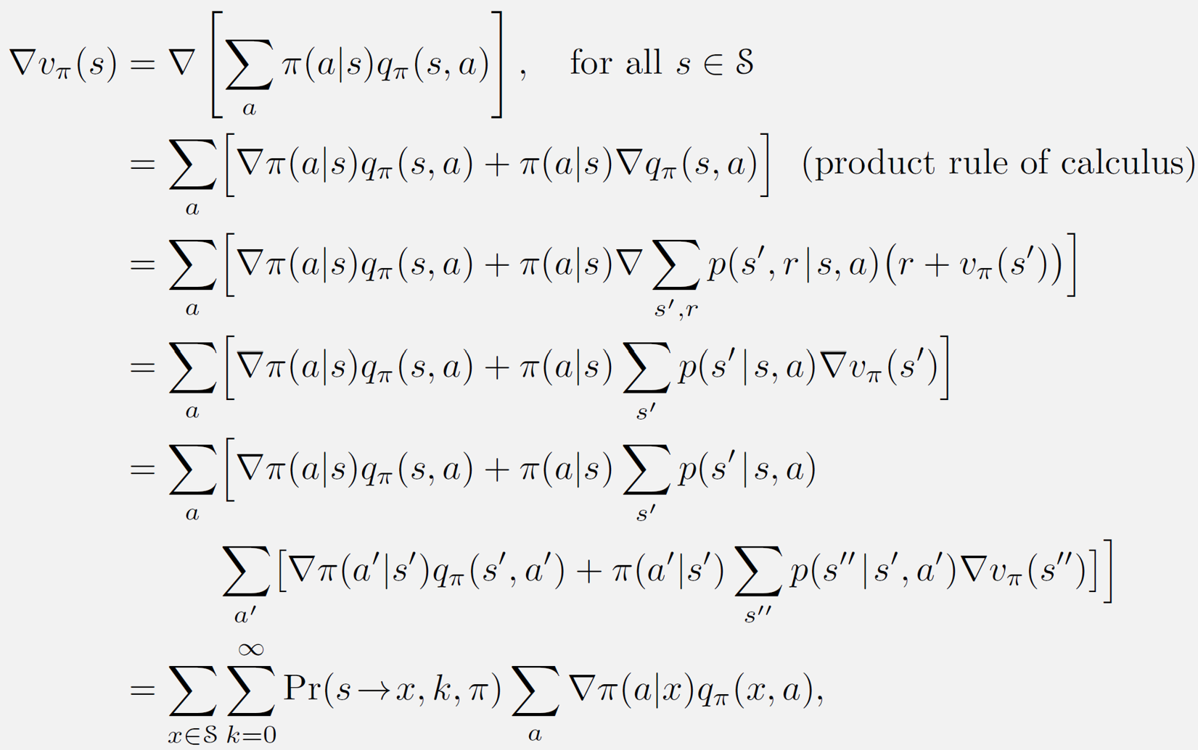
Policy Gradient Theorem
Episodic task as an example
recursion!

Slide 9
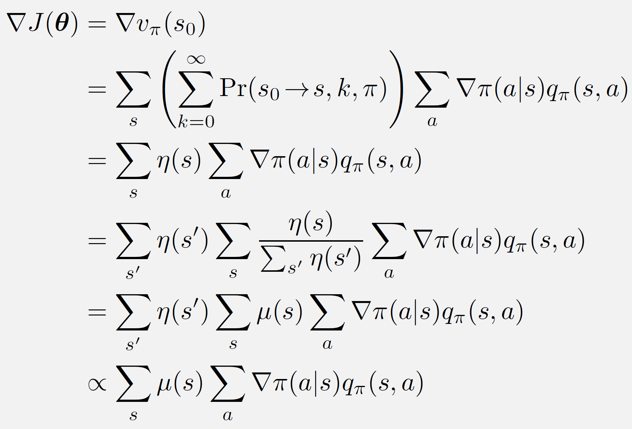
Policy Gradient Theorem
Expected number of visits under policy $π\left(a | s\right)$, recall state occupancy matrix
Stationary state distribution under policy $π\left(a | s\right)$
move the constant into the step size of gradient ascent
The return after taking this action
The reason we take this action

Slide 10
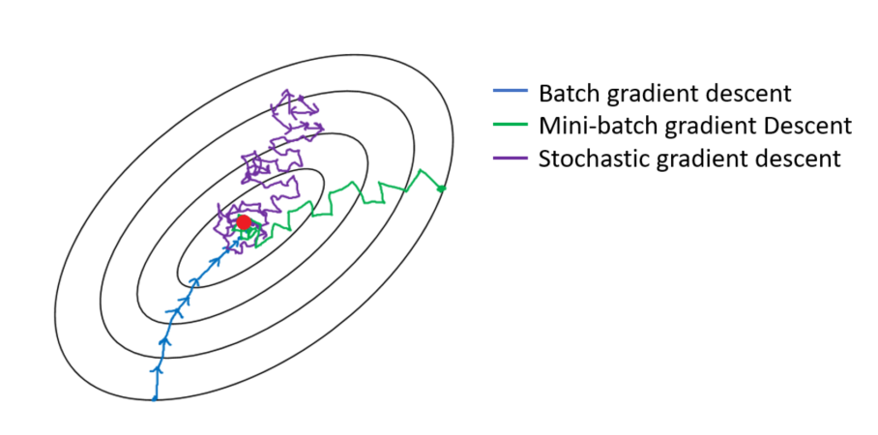
REINFORCE: Monte Carlo Policy Gradient
Stochastic gradient descent
$θ←θ−η∇Q(x_{i},θ)$
Gradient at a sampled point

Slide 11
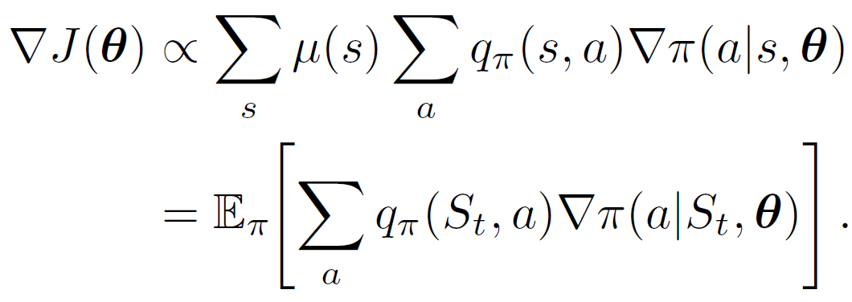
REINFORCE: Monte Carlo Policy Gradient
Sample gradients for policy optimization
On policy
Target for Monte Carlo method

Slide 12
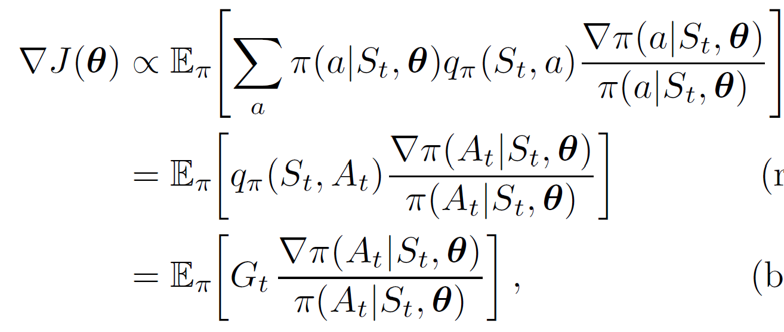
REINFORCE: Monte Carlo Policy Gradient
Sample gradients for policy optimization
Action taken by policy $π\left(a | s\right)$
Gradient: the direction and rate of fastest increase
Return under policy $π\left(a | s\right)$
Encourage the action that leads to a high return
Discount the action that is preferred by the current policy
Sample gradient for policy update
A sample of return, needs to wait for the episode
Completely from the environment, no need to know the MDP!

Slide 13
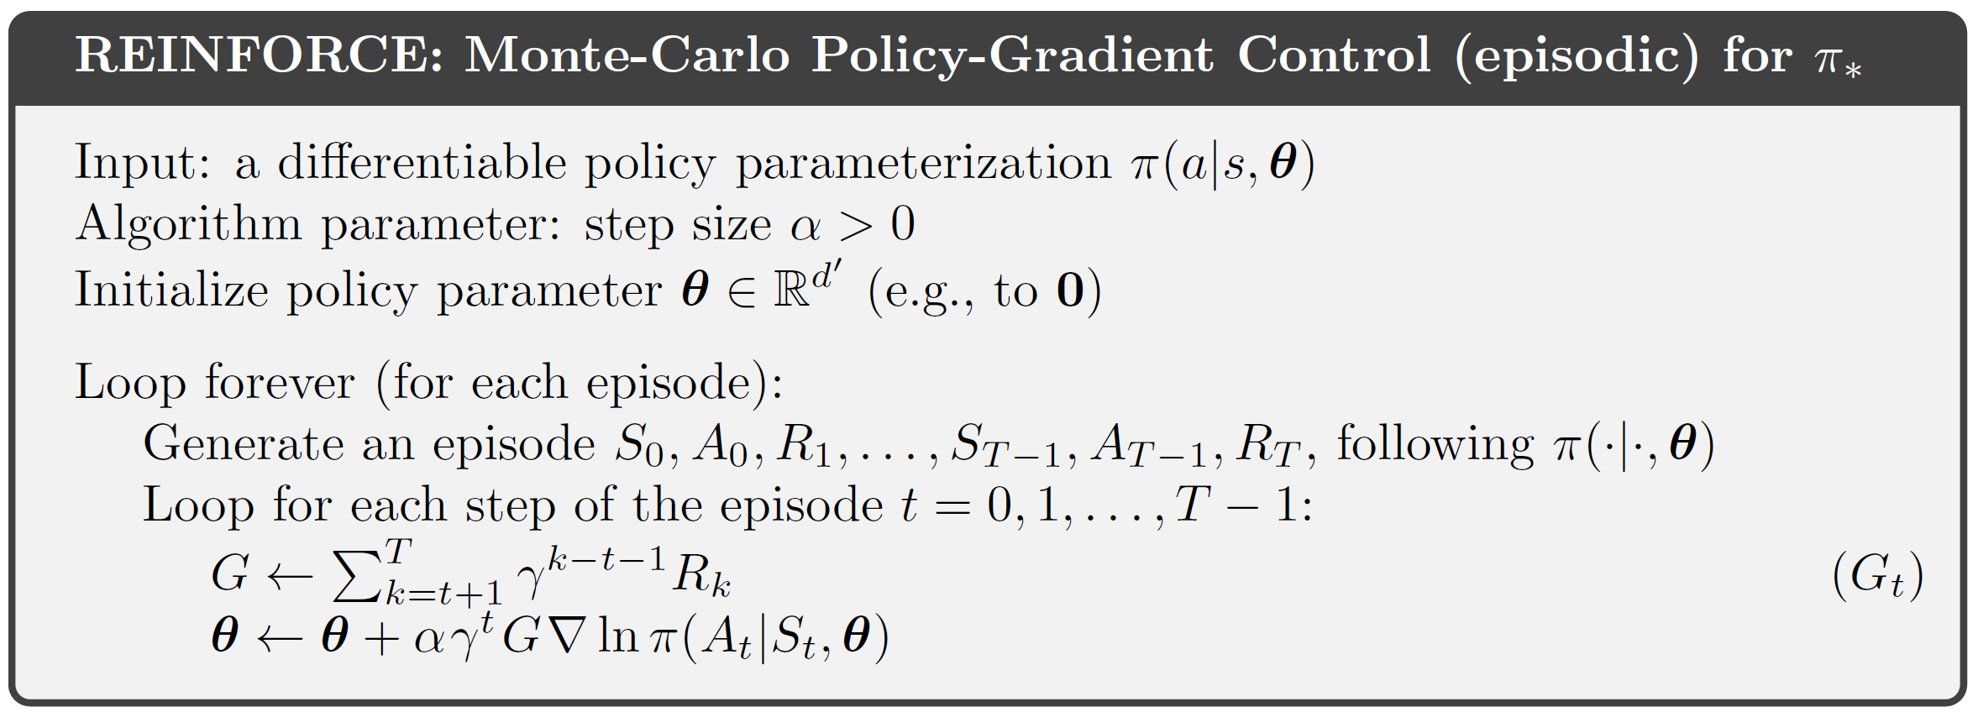
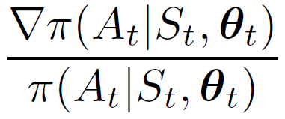
REINFORCE: Monte Carlo Policy Gradient
It has to be an on-policy method!
This is the updated policy!
Bring back the discount factor $γ$

Slide 14
Construction of policy
Softmax policy – discrete action space
Parameterized state-action pair $φ\left(s,a\right)∈R^{d}$
A stochastic policy $π\left(a | s\right)∝\exp\left(θ^{⊤}φ\left(s,a\right)\right)$
Gradient: $∇_{θ}\log{π\left(a | s\right)}=φ\left(s,a\right)−E_{a∼π}\left[φ\left(s,a\right)\right]$
Gaussian policy – continuous action space
Parameterized states $φ\left(s\right)∈R^{d}$
A stochastic policy $π\left(a | s\right)∝N\left(θ^{⊤}φ\left(s\right), σ^{2}\right)$
Gradient: $∇_{θ}\log{π\left(a | s\right)}=\frac{\left(a−θ^{⊤}φ\left(s\right)\right)}{σ^{2}}φ(s)$
a feature vector
a distribution over actions
a feature vector about the state
a scalar action can be extended to vectorized actions

Slide 15
REINFORCE with baseline
REINFORCE is a Monte Carlo method in nature
Suffer from a high variance (just as in SGD)
Use a baseline function for variance reduction
Typical choice: $b\left(s\right)=v\left(s\right)$, which leads to the advantage function
Any function independent of action $a$
$A_{π}\left(s,a\right)=q_{π}\left(s,a\right)−v_{π}(s)$

Slide 16
REINFORCE with advantage function
Approximated advantage function

Slide 17
REINFORCE: Monte Carlo Policy Gradient
In REINFORCE return is used to “evaluate” an action
Vanilla version
With advantage function
$$∇J\left(θ\right)∝E_{π}\left[G_{t}\frac{∇π\left(A_{t} | S_{t},θ\right)}{π\left(A_{t} | S_{t},θ\right)}\right]$$
$$∇J\left(θ\right)∝E_{π}\left[{(G}_{t}−V(S_{t}))\frac{∇π\left(A_{t} | S_{t},θ\right)}{π\left(A_{t} | S_{t},θ\right)}\right]$$
Do we need to wait until the episode finishes? Let’s bootstrap with TD methods!

Slide 18
Actor-Critic Methods
One-step actor-critic
Let’s bootstrap this
Critic evaluates actions
Actor takes actions
Only need one step sampling from environment
Based on the current value model estimate, everything we have learnt so far applies (e.g., MC/TD)!
A source of bias due to bootstrapping!

Slide 19
One-step Actor-Critic Methods
No need to generate an episode!
One-step return with baseline
Key to generalize to n-step methods
Why is this?

Slide 20
Actor-Critic Methods
One-step actor-critic
This can also be executed at different time scales
Action-value
State-value
Advantage function:
$$A_{π}\left(A_{t},S_{t}\right)=Q_{π}\left(A_{t},S_{t}\right)−V(S_{t})$$
TD error of $V(S_{t})$, no need to separately estimate the Q-function
TD(0)
n-step TD
Q($σ$)
TD($λ$)

Slide 21
Revisit REINFORCE
Problems in practice
What if the new policy leads to an unexplored state?
Bad value estimation there!
Stop here, if use TD methods
Problems? Serious bias!
Stop here, if use MC methods
Problems? High variance, no incremental update
Move policy not too far away from the current one: 1) Proximal Policy Optimization
2) Trust Region Policy Optimization

Slide 22
Takeaways
Directly estimate policy, as it is eventually what we care about
No need to follow Bellman equation, and therefore more flexible
Higher variance and harder to optimize
Everything we have learnt for value estimation can be used here
Actor-Critic methods

Slide 23
Suggested reading
Chapter 13: Policy Gradient Methods

